Slide 1


SSM INSTITUTE OF ENGINEERING AND TECHNOLOGY DINDIGUL - 624 002
Department of Electronics and Communication Engineering
A Deep Learning Based Approach for Grading of Diabetic Retinopathy Using Large Fundus Image Dataset
Guided By,
Mr.Manikandan A ,AP/ECE
SSMIET.
Presented By,
Keerthana T (922119106039)
Madhumitha B (922119106051)
Mahalakshmi R M (922119106052)
Malini S (922119106053)

Slide 2
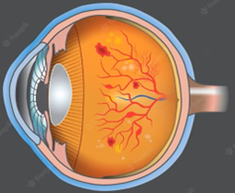
OBJECTIVE
To classify the severity of Diabetic Retinopathy (DR) which causes severe vision loss to diabetic patient. It is classified based on Deep Learning by using Large Fundus Image Dataset.

Slide 3
INTRODUCTION
Diabetic retinopathy (DR) in the leading cause of avoidable visual loss in people of working age in developed countries.
The disease’s global prevalence in estimated to rise at an exponential rate, reaching 529 million by 2030.
This is concerning for Worldwide National Health care, as affects people's ability to work, putting the economy in jeopardy.

Slide 4
LITERATURE SURVEY
S.NO | TITLE | AUTHOR NAME | YEAR OF PUBLICATIONS | METHOD
1. | Development and validation of a deep learning algorithm for detection of diabetic retinopathy in retinal fundus photographs | Mohamed,E;Abd Elmohsen | 2019 | The majority decision of all ophthalmology status are taken as majority of the ophthalmologists could not identify the correct findings for images it is difficult to perform algorithm well this is a main drawback for this paper.
2. | Development and validation of a deep learning algorithm for detection of diabetic retinopathy in retinal fundus photographs |  | 2020 | The original study used the EYEPACS dataset and Messidor-2 dataset to evaluate the algorithm performance. Eyepacs is a dataset which is based on the DR system to simplify process of image capture in this the main drawback is they did not provide hyper parameter settings.
Alexander R

Slide 5
S.NO | TITLE | AUTHOR NAME | YEAR OF PUBLICATIONS | METHOD
3. | Transfer learning based detection of diabetic retinopathy from small dataset | Farag,M.M;Abdel-Haamid | 2022 | They have used the Inception-v3 model to develop the algorithm performance and helps to extract different sized features of input images in one level of convolution.
4. | Deep learning approach to diabetic retinopathy detection | Ayesha,N;Javed,R | 2020 | It is the early detection of the diabetic retinopathy for the treatment in this automatic deep learning method is used for stage detection of single photography.
5. | Diabetic retinopathy detection and retinal image generation | Alauthman,M;Alkasassbeh | 2021 | They visualize the symptom encoded in the image and then propose the pathogen model to synthesize the retinal images ,they generate an image it may take long time but in this by using pathogen network our image takes less time and it can be used both by doctors as well as users.

Slide 6
PROBLEM DEFINITION
Diabetic Retinopathy (DR) is a chronic eye disease, commonly found in elderly people (age 50 or above), and can cause severe visual impairments or even blindness if not treated at an early stage [1].
DR is caused by the blood vessels rupturing due to high blood sugar levels.
These leaky vessels produce fluid clots and oxygen deficiency, leading to severe visual impairments
However, the progression of the disease can be reduced if diagnosed at an early stage.

Slide 7
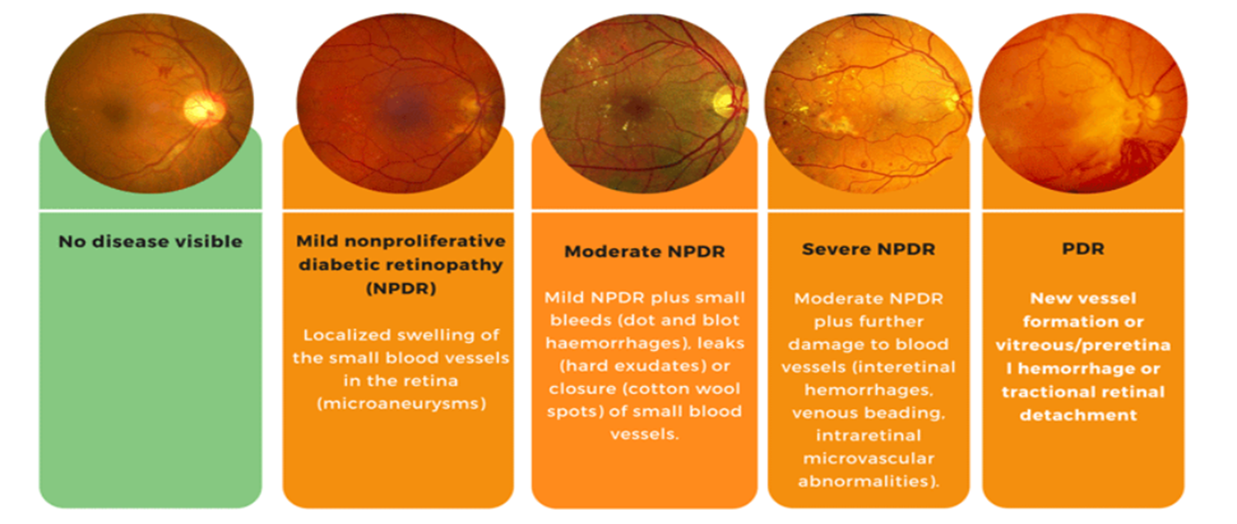
TYPES 0F DIABETIC RETINOPATHY
DR is classified into two types, i.e., Proliferative and Non Proliferative Diabetic Retinopathy (NPDR).
PDR which results in complete blindness.
NPDR is graded into three stages ,
(i)Mild (ii)Moderate (iii)Severe NPDR
Severe NPDR is transmitted into PDR due to lack of proper and timely treatment.

Slide 8
BLOCK DIAGRAM OF PROPOSED METHOD
INPUT
PREPROCESSING
SEGMENTATION
CLASSIFICATION
OUTPUT

Slide 9
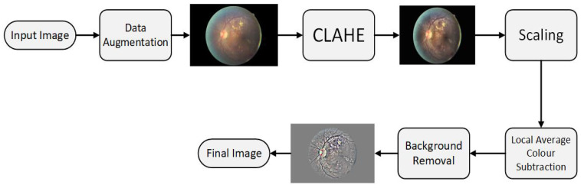
PRE PROCESSING PHASE
DATA AUGMENTATION – Flipping to 90 degree, rotating image by (0,180) degree.
CLAHE – Algorithm used Contrast Limited Adaptive Histogram Equalization.
SCALING – Pixel Size [300 PIXELS OR 500PIXELS].
COLOUR NORMALIZATION AND BACKGROUND REMOVAL – Removed Background and Unwanted Details.
Gray Scale Mapping – Local Average to 50% Gray Scale image.
Resizing – Finally we Resized to 256 x 256.

Slide 10
SEGMENTATION
CONVOLUTION
MAXPOOLING LAYER
ACTIVATION LAYER
DROUPOUT LAYER
FULLY CONNECTED LAYER
FEATURE VECTOR

Slide 11
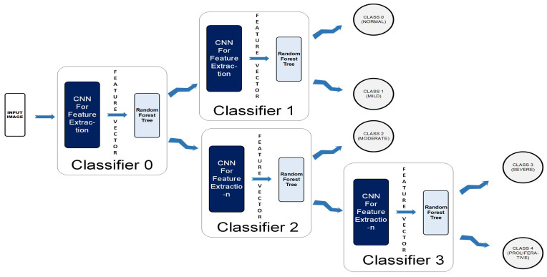
CLASSIFICATION
A Colored Fundus image(256 x 256 x3) is fed to the CCN as input.
The output map is sequentially forwarded from the previous one to the next four classifiers within the CCN.
The new test color fundus image moves node-wise and ultimately reaches one of the five leaf nodes (terminal nodes) for final decision-making.
Finally, it can be classified among one the five classes: Normal, Mild, Moderate, Severe, and Proliferative.

Slide 12
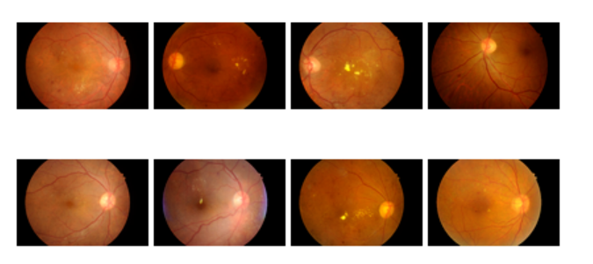
TOOL
MATLAB(2021)
DATASET
Two Public Dataset INDIAN DIABETIC RETINOPATHY IMAGE DATASET(IDRiD) and MESSIDOR DATABASE
INDIAN DIABETIC RETINOPATHY IMAGE DATASET(IDRiD) Contains 516 Retina images
MESSIDOR DATABASE Contains 1748 Retina images
SAMPLE DATASET

Slide 13
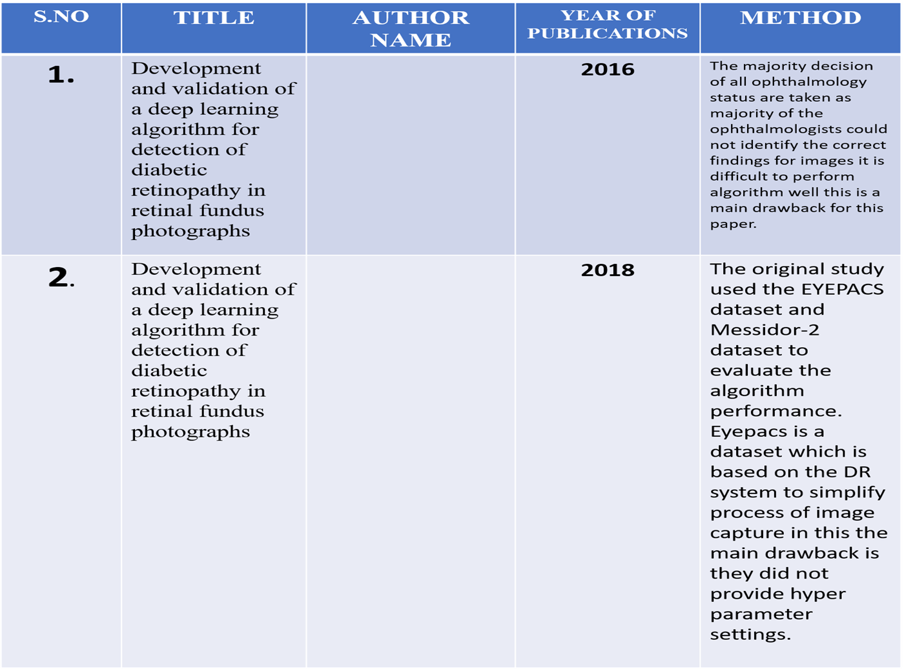
CONCLUSION

Slide 14
REFERENCES:
1. Taylor, R. & Batey, D. Handbook of Retinal Screening in Diabetes: Diagnosis and Management. Wiley (2021).
2. Wang, F., Casalino, L. P. & Khullar, D. Deep Learning in Medicine-Promise, Progress, and Challenges. JAMA Intern Med. (2020).
3. Guan, M. Y., Gulshan, V., Dai, A. M. & Hinton, G. E. Who Said What: Modeling Individual Labelers Improves Classification. arXiv e-prints., https://ui.adsabs.harvard.edu/\#abs/2017arXiv170308774G. (Accessed March 01, 2020).

